Slide 1


Read More
Page 01/26
Analysis on
Credit Card
Spending
in
INDIA
USING MY SQL
NILOY SAHA

Slide 2


Read More
Page 02/26
About dataset
This dataset contains insights into a collection of credit card transactions made in India, offering a comprehensive look at the spending habits of Indians across the nation.
Total number of columns is 6
Total number of rows is 26052
Save This Post

Slide 3
Read More
Overview of Columns
Page 03/26
City: The city in which the transaction took place.
Date: The date of the transaction.
Card Type: The type of credit card used for the transaction.
Exp Type: The type of expense associated with the transaction.
Gender: The gender of the cardholder.
Amount: The amount of the transaction.
Save This Post

Slide 4
Read More
Agenda for This Analysis
Page 04/26
Total usage of different types cards .
Cities with Highest Card Usage
Spending Patterns by City .
Most Popular Card Type .
Highest Revenue-Generating Card.
Gender-wise Spending Behavior.
High-Value Transactions.
Most Common Expense Type.
City × Card Type Combination.
Card Type × Gender Combination.
Spending Distribution..
Opportunities & Recommendations
Save This Post

Slide 5
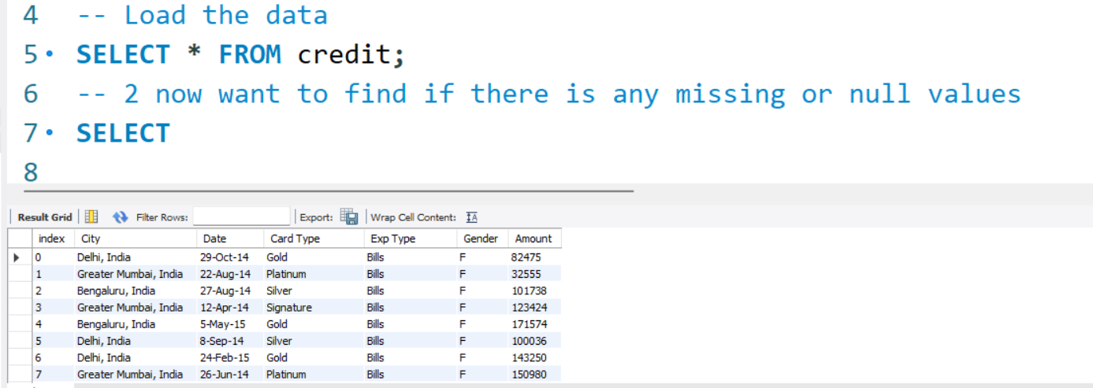

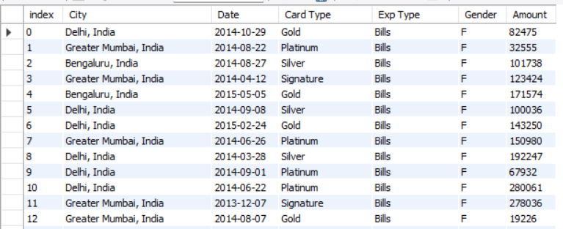
Data Cleansing
Read More
Page 05/26
Data loading
Result
Save This Post

Slide 6
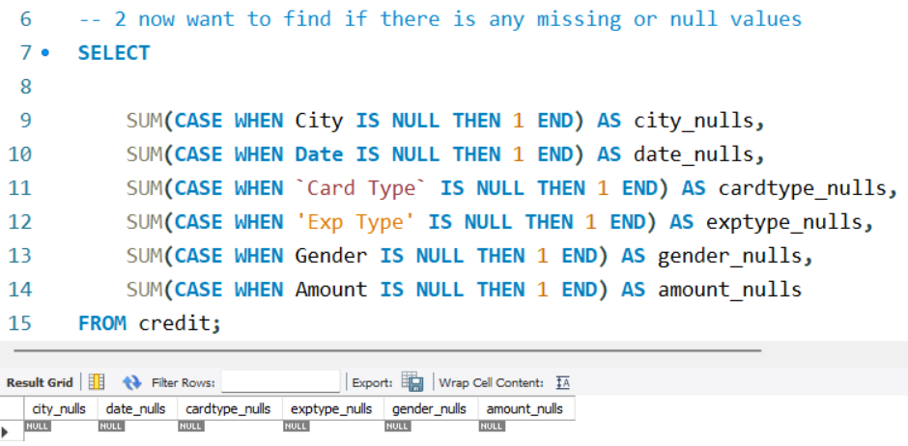
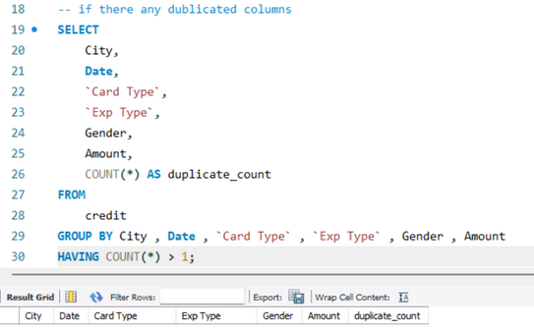
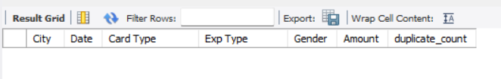
Data Cleansing
Read More
Page 06/26
Identifying Any Missing Values
There is no null values
Identifying Duplicate Values
There are no duplicate values.
Save This Post

Slide 7
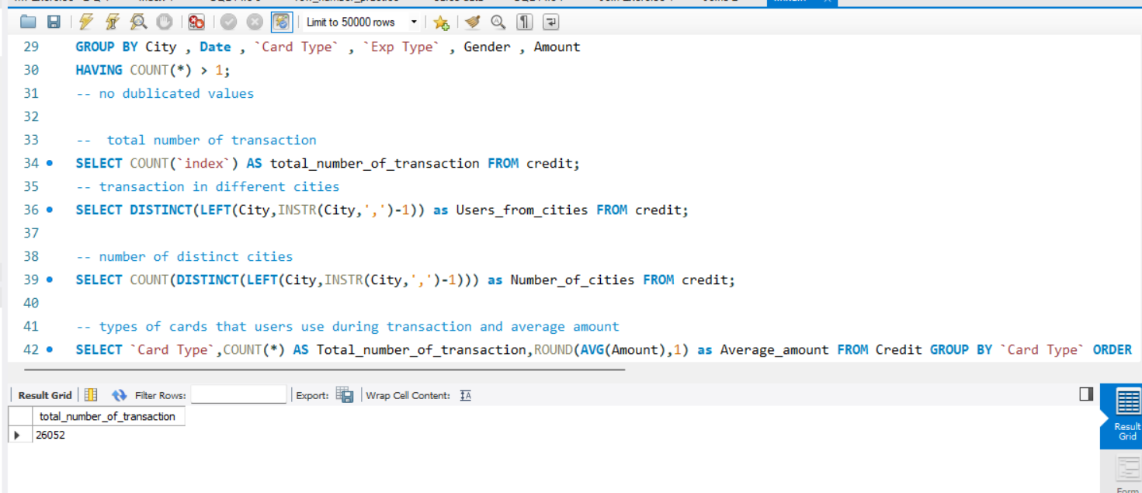
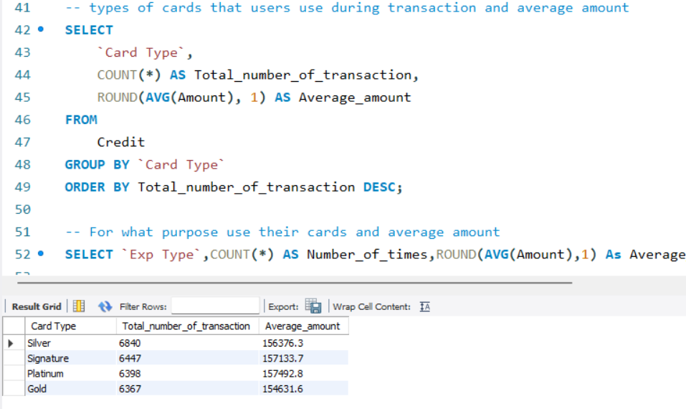
Analysis
Read More
Page 07/26
Total number of transaction
Total transactions is 26052
Types of Cards and Average Expenditure
The usage rate is higher for silver cards, with an average expenditure of 1,56,376 rupees.
However, on average, users of platinum cards spend the most.
Save This Post

Slide 8
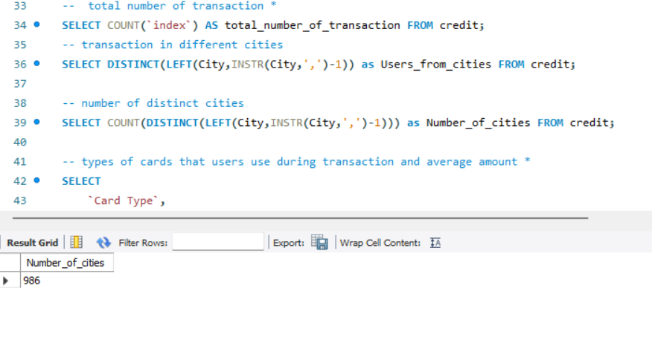
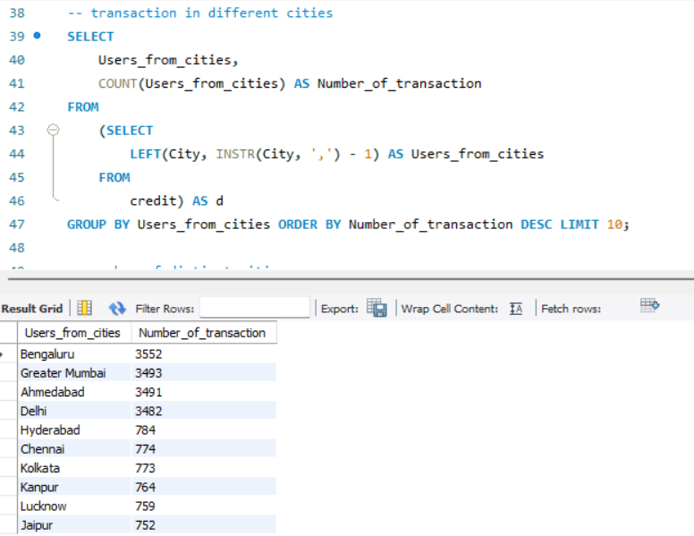
Analysis
Read More
Page 08/26
Total Count of Cities in Our Dataset
Number of cities 986
Cities and Their Number of Transactions
In our data 4 Tier-1 cities and 6 Tier-2 cities are present
Total Tier-1 cities are Bengaluru, Greater Mumbai, Ahmedabad, Delhi
Total Tier-2 cities are Hyderabad ,Chennai ,Kolkata, Kanpur, Lucknow ,Jaipur
Save This Post

Slide 9
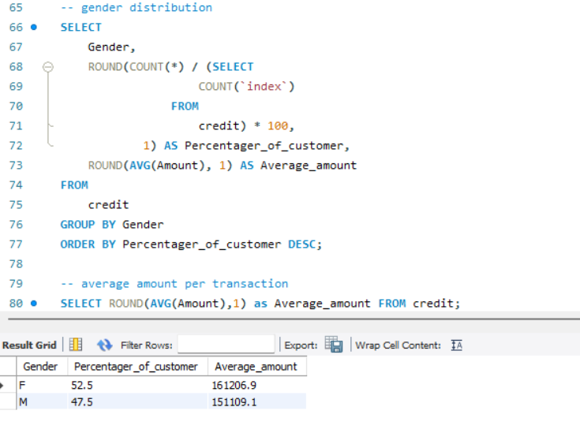
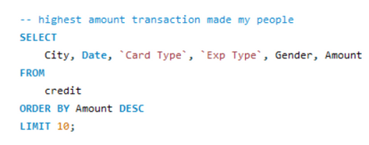
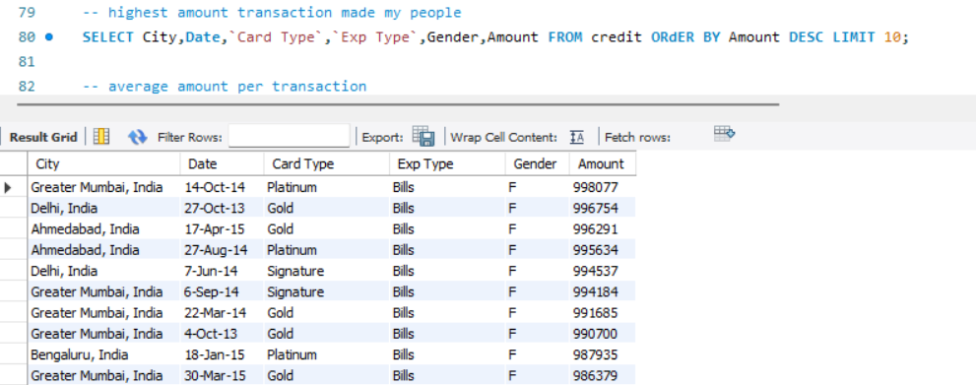
Analysis
Read More
Page 09/26
Gender Distribution Analysis
Females account for over 52.5% of total transactions, whereas males make up 47.5%.
The total amount spent by females is 1,61,206 rupees, while males have spent 1,51,109 rupees.
Top 10 cities with the largest transaction volume
Save This Post

Slide 10
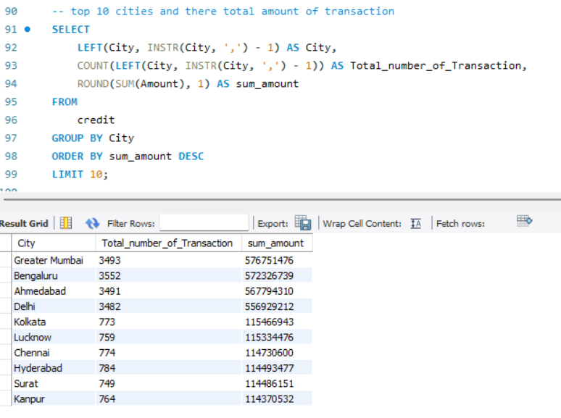
Analysis
Read More
Page 10/26
It is evident that female customers primarily engage in higher volume transactions.
High-value payments predominantly occur in Tier 1 cities such as Bengaluru, Greater Mumbai, Ahmedabad, and Delhi.
This type of transaction mostly made for bills
Top 10 Cities with the Highest Total Amount
The majority of the top cities are Tier-1 and Tier-2 locations.
Save This Post

Slide 11
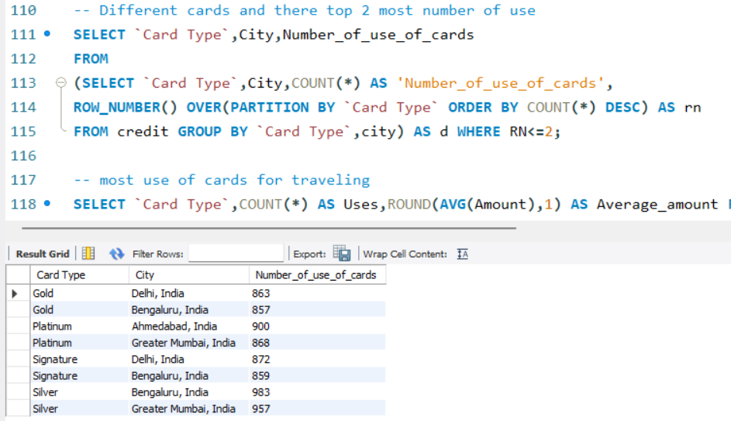
Analysis
Read More
Page 11/26
Different Cards and Their Top Two Cities
Gold cards are predominantly utilized in Delhi and Bengaluru.
Platinum cards are primarily found in Ahmedabad and Greater Mumbai.
Signature cards are mainly popular in Delhi and Bengaluru.
Silver cards are frequently used in Bengaluru and Greater Mumbai.
Save This Post

Slide 12
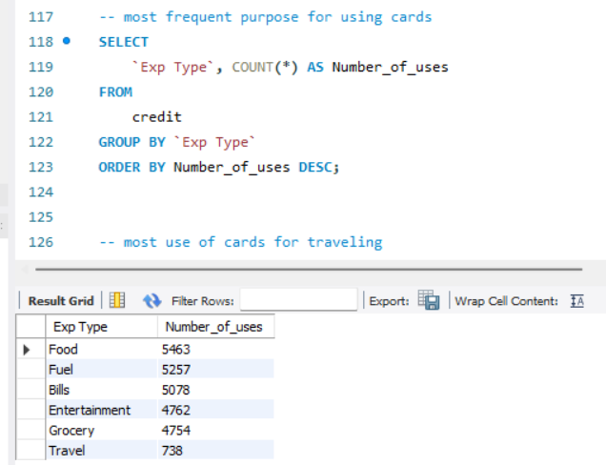
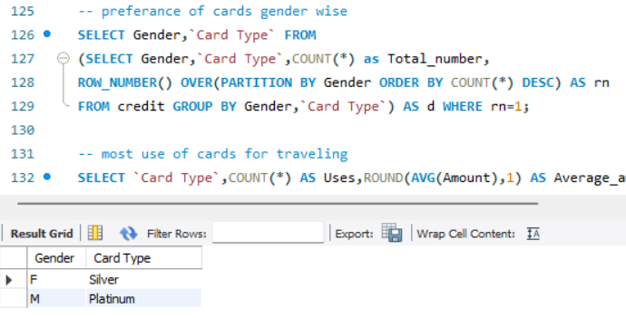
Analysis
Read More
Page 12/26
Common purposes for using credit cards
Users most frequently utilize cards for food purchases.
Following that, cards are used for fuel, bills, entertainment, and groceries.
However, there is a significant gap in card usage for travel expenses.
Gender and Their Most Preferred Card Types
Female = Silver
Male=Platinum
Save This Post

Slide 13
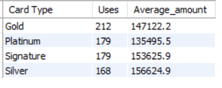
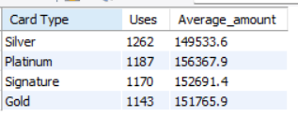
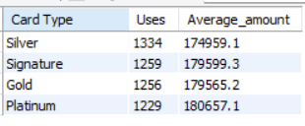
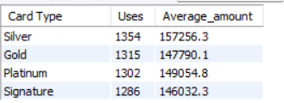
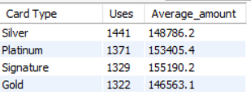
Analysis
Read More
Page 13/26
Different purpose and its favourite card type
For travel
For entertainment
For billing
For fuel
For food
In most of the purposes silver card is mostly used my users
Platinum cards consistently show the highest average spending
Save This Post

Slide 14
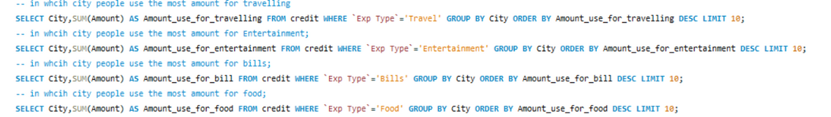
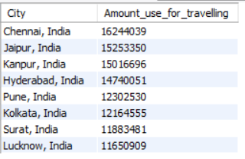
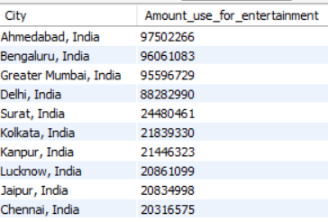
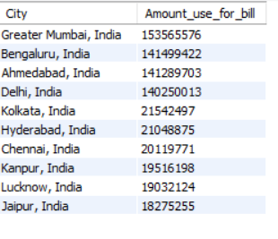
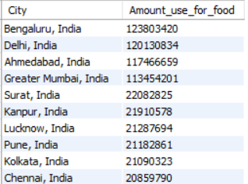
Analysis
Read More
Page 14/26
Cities and their highest Amounts for Various Purposes
Save This Post

Slide 15
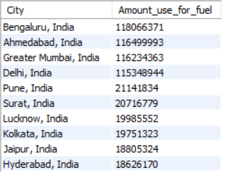
Analysis
Read More
Page 15/26
Chennai spends the most on travel among all cities.
Ahmedabad leads in entertainment spending.
Greater Mumbai records the highest billing amount.
Bengaluru spends the most on food transactions.
Bengaluru also leads in fuel-related spending.
Tier-1 metros lead in entertainment, billing, food and fuel spending, while travel spending is highest in Tier-2 cities like Chennai, Jaipur and Kanpur.
Save This Post

Slide 16
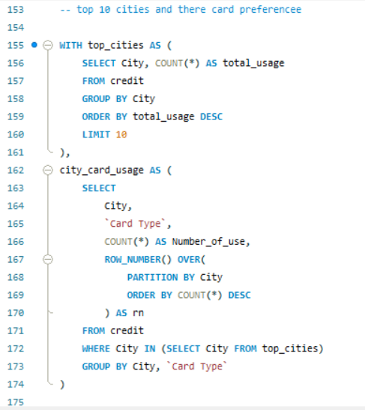
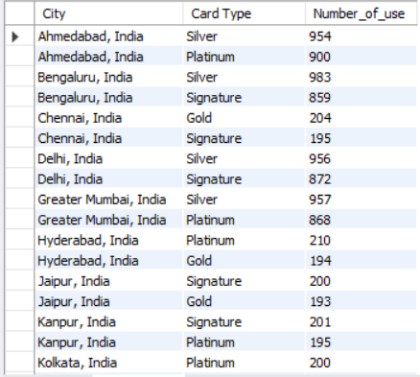
Analysis
Read More
Page 16/26
Top 10 Cities and Their Card Preferences
Ahmedabad: Silver card is most used, followed closely by Platinum.
Bengaluru: Silver leads with high usage, followed by Signature.
Chennai: Gold and Signature are used almost equally.
Save This Post

Slide 17
Analysis
Read More
Page 17/26
Delhi: Silver dominates, with Signature as the second choice.
Greater Mumbai: Silver has the highest usage, followed by Platinum.
Hyderabad: Platinum and Gold are nearly equal in preference.
Jaipur: Signature card is the top preference.
Kanpur: Signature leads slightly over Platinum.
Kolkata: Platinum leads slightly over silver.
Lucknow: Signature and gold are more used
Save This Post

Slide 18
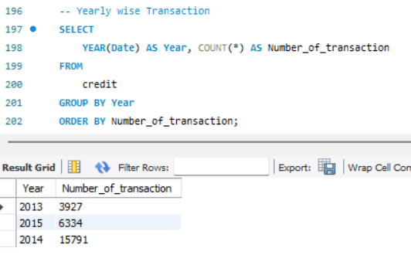
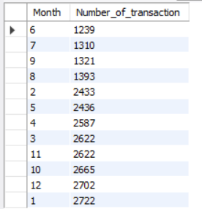
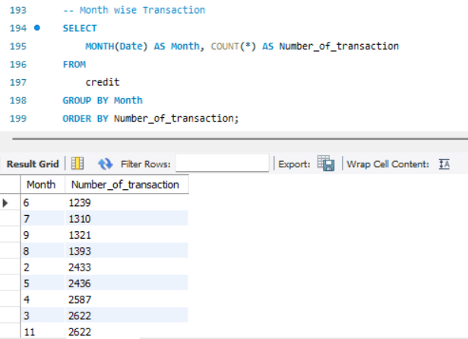
Analysis
Read More
Page 18/26
Yearly transaction
Monthly Transaction History
November (Month 11) shows the highest transactions, indicating peak customer activity.
March (Month 3) and April (Month 4) also record very high usage, showing strong first-quarter activity.
Save This Post

Slide 19
Analysis
Read More
Page 19/26
May (Month 5) and June (Month 6) show moderate transaction volume.
August (Month 8) and September (Month 9) show steady but lower activity.
Overall trend: Year starts strong (Mar–Apr), peaks in Nov, and dips mid-year.
2014 recorded the highest number of transactions (15,791), showing a major spike in customer activity.
2015 shows a moderate drop with 6,334 transactions, indicating reduced engagement compared to 2014.
2013 has the lowest transactions (3,927), showing that activity grew sharply after 2013.
Save This Post

Slide 20
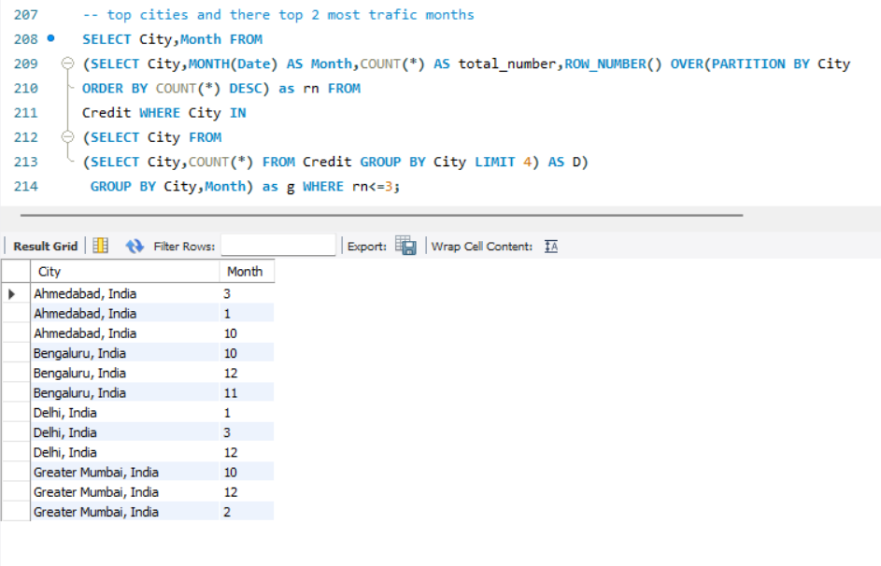
Analysis
Read More
Page 20/26
Major Cities and Their Busiest Months
October is high for Bengaluru, Mumbai, Ahmedabad:
Navratri
Dussehra
Diwali shopping begins
Big Billion Days + Amazon Great Indian Festival
Wedding shopping season starts
This naturally boosts food, entertainment, apparel, electronics, and travel spending, which is exactly what your dataset reflects.
Save This Post

Slide 21
Analysis
Read More
Page 21/26
2, .Why November spikes:
Diwali (India’s biggest spending festival)
Post-diwali sales
Travel + gifting + gold purchase
Wedding season begins fully
Cities like Bengaluru, Mumbai, Delhi show strong November activity because:
More online shopping
More restaurant/eating out
Family gatherings
High-value bills (appliances, electronics)
3. Why December is high:
Christmas
New Year celebrations
Holiday travel season
Salary bonuses → higher discretionary spending
Cities with strong nightlife (Bengaluru, Mumbai) show spikes.
Save This Post

Slide 22
Analysis
Read More
Page 22/26
4. Why March is high in Delhi, Ahmedabad:
Financial year-end → tax savings, bill clearances
Many people pay:
Insurance
Investments
Credit card bill clearance
Companies do reimbursements → spending increases
Also: Holi (food + travel + shopping)
This is not a festival peak, but a financial peak.
5,Why Jan shows high activity in Ahmedabad:
New Year celebrations
Winter sales
Holiday return expenses
Wedding season continues
Save This Post

Slide 23
Analysis
Read More
Page 23/26
6.Why Feb appears in Mumbai:
Valentine’s week (restaurants, entertainment)
Winter wedding season
Big sales (end of season)
Travel + gifts peak
Overall
Credit card usage in India peaks predominantly during major festival months (Oct–Dec) and financial-year cycles (March). October and November’s spike aligns directly with Diwali, Dussehra, Navratri, and mega e-commerce sales, while December reflects holiday travel and New Year spending. March peaks due to tax planning, bill payments, and Holi-related expenses.
Save This Post

Slide 24
Advices
Read More
Page 24/26
To achieve maximum engagement, plan your offers, discounts, and campaigns for the months of October, November, December, and January.
March shows a strong spike due to tax-saving, bill settlements, and Holi spending. Banks and retailers should push financial products, EMI options, and investment-linked offers during this month.
Premium card promotions (Platinum/Signature) will perform best in Bengaluru, Mumbai, Ahmedabad, and Delhi .
Push Silver for mass campaigns
Push Platinum during festivals & travel season
Females contribute to 52.5% of all transactions, with higher total spend. Silver and Signature card-based campaigns can be targeted more towards female customers.
Save This Post

Slide 25
Advices
Read More
Page 25/26
Each city has predictable spending months. Use this data for localized campaigns.
Travel spending is comparatively low. Offering travel cashback, lounge access, or air miles in off-peak months can improve card usage.
Understanding seasonal & festival-driven patterns helps in Optimizing offers,Improving customer retention,Increasing spending per card ,Enhancing credit risk decisions
Save This Post

Slide 26



Read More
Page 26/26
Thank you for viewing my analysis!
If you found this insightful, do connect or drop your feedback — always happy to learn and improve.
Share this with someone who is ready to turn raw data to insights
Save This Post

